Slide 1

Membership
2018-2019
Path to Star Council
Path to Star District
Path to Circle of Honor

Slide 2

Year to Date Stats
Intake Gain – State Goal – 360, currently at 160 (14th Orderwide)
Net Gain – Goal 250, currently at 88 (33rd order wide)
Net-Net – Goal 75, currently at 22 (27th orderwide)
As of 01/10/2019

Slide 3
Year to Date Stats
0 Star Districts – 1 Districts at 50% or higher District 8 – 64%
6 Councils have reached their member goals – 8038, 8285, 9673, 10901, 14051, 16433
5 more are at 70% or higher – 1522, 7854, 8054, 9409, 13471
4 Councils between 50 and 70% - 2180, 6592, 11541, 15382
As of 01/03/2019
Notes:
8285, St. Therese, Jackson, 9673 Woolmarket, 14051 Olive Branch, 16433 Waveland
9409 West Biloxi, 10901 Oxford
2180 Laurel, 6592 Bassfield, 7854 Clinton, 8054 McComb, 13471 Philadelphia, 15382 Hattiesburg

Slide 4
Year to Date Stats
2 councils met insurance goal – 1522, 11995
3 councils at 50% or higher – 7087, 8038, 9409
As of 01/03/2019
Notes:
119995 Pass Christian, 1522 Bay St. Louis (1), 9409 West Biloxi (2), 9673 Woolmarket (1), 16433 Waveland (1)

Slide 5
Year to Date Stats
26 councils have not recruited 1 new member
Loss of 70 members from 12 councils – 2 council totaled 38 members
As of 12/27/2018
Notes:
Largest losses in Council 802 Meridian (17) and 1244 Biloxi (21)

Slide 6
Councils with
Zero net growth
848 | 1034 | 1583 | 1605 | 2134
2945 | 5267 | 5556 | 5654 | 6872
7211 | 7915 | 7974 | 8760 | 8848
8912 | 9234 | 9958 | 10499 | 11904
11956 | 12166 | 12271 | 12331 | 13936
15155
Notes:
8285, St. Therese, Jackson, 9673 Woolmarket, 14051 Olive Branch, 16433 Waveland
9409 West Biloxi, 10901 Oxford
2180 Laurel, 6592 Bassfield, 7854 Clinton, 13471 Philadelphia, 15382 Hattiesburg
119995 Pass Christian, 9409 West Biloxi (2), 9673 Woolmarket (1), 16433 Waveland (1)
Largest losses in Council 802 Meridian (17) and 1244 Biloxi (21)

Slide 7
Membership Incentives
Council Incentive – STATE YEAR
  3 Councils met recruiting and insurance 1522 Bay St. Louis, 9673 Woolmarket, and 14051 Olive Branch
  8 Councils met recruiting goal
    2969 Clarksdale, 7854, Clinton, 8038 Pearl, 8285 St. Therese, 11541 Gulfport, 15121 Poplarville, 15382 Hattiesburg, and 16433 Waveland
  2 Council met insurance goal
    9409 West Biloxi and 11995 Pass Christian
As of 12/31/2018

Slide 8
Membership Incentives
Individual Incentive – FRATERNAL YEAR
Recruit 5 or more members in either 1st Quarter or 2nd Quarter of year – Receive $50 from State.
  1st Quarter July 1st to September 30th
    No Winners
    3 New Members – Benji Borrelli, Council 1244
  2nd Quarter October 1st to December 31st
    No Winners
    4 New Members – Thad Anderson, Counci 9673
  Robert Agostinelli, Council 2629 4 members this year.

Slide 9
E-Membership
13 New Members in Fraternal Year
12 Assigned E-members not converted
  8 Selected council – still not converted
  4 Members from previous year not converted
2 Unassigned E-members
  1 Unassigned (did not select a council)
  1 Rejected for eligibility concerns.
7 Online Only Members

Slide 10
E-Membership
26 Total Online Members
7 Online Members Converted
  27% Conversion Rate
    Bottom 5 Jurisdiction distinction
Current Average Days Assigned-
  146 Days (~5-months)
Assigned | Member | Member # | City | Date Assigned | Days
5267 | Billy Dunn | 5029498 | Greenwood | 7/31/2018 | 156
5267 | Michael L Barner | 5032604 | Greenwood | 9/20/2018 | 105
6765 | Lance Christopher Atchley | 5028225 | Starkville | 7/23/2018 | 164
6765 | Mr William Reimann | 5028273 | Starkville | 9/6/2018 | 119
7854 | Andy Thaggard | 5047354 | Clinton | 12/7/2018 | 27
7974 | Mr Zachary R Wolcott | 5012936 | Columbus | 5/2/2018 | 246
7974 | Marvin M Estrada | 5017067 | Columbus | 5/23/2018 | 225
8848 | Mr Bradley A Halberstadt | 5041192 | Belden | 12/7/2018 | 27
9094 | Clinton H Brown | 5036627 | Biloxi | 9/20/2018 | 105
10443 | Mr Samuel C Stewart | 5026323 | Grenada | 7/6/2018 | 181
11934 | Jerry Guillory | 5021051 | Madison | 6/13/2018 | 204
15131 | Mr David A Rueff | 5024655 | Madison | 6/27/2018 | 190

Slide 11
Membership
Path to Star/CoH
What is next ?
  Coordinated Church Drives
    Letters to Bishops
      Biloxi Diocese – End of January
      Jackson Diocese - ???

Slide 12
Why Earn Star Council
  Grow your council
  Grow you council’s charitable outreach
  Grow the impact of your council within your community
  Imagine impact on society with more Knights.

Slide 13
Recruitment
  Our Responsibility as leaders of the Knights of Columbus is to assure the continued growth and sustainability of our Order. This is our first and primary responsibility. While we have other goals and activities that are necessary, no other task is sufficient to advance the good of the Order if we do not advance membership growth. Everything we do depends on membership.
  Supreme Knight Carl Anderson 2016

Slide 14
Recruitment
  Why do men join?
  Fellowship
  Faith formation
  Make a difference

Slide 15
Council Membership Team
Membership Chairmen
  Recruitment Team
    Size varies depending
    All council members can be part
  Admissions Team
    7 members - according to Supreme
    Review Potential Members
  Retention Team
    1 RT member/10 council members
Notes:
Sacramental events include baptism, first communion, confirmation. Could also be a faith program.
RCIA Candidates after acceptance into church, but can start working with them before.
Work with seniors to introduce them to Catholic groups at their chosen college or university.

Slide 16
Council Membership Growth – Recruitment Plan
How to identify potential members:
  Become part of parish welcoming committee
  Recognize families during sacramental events***
  RCIA candidates
  Catholic High School Seniors
Notes:
Sacramental events include baptism, first communion, confirmation. Could also be a faith program.
RCIA Candidates after acceptance into church, but can start working with them before.
Work with seniors to introduce them to Catholic groups at their chosen college or university.

Slide 17
Council Membership Growth – Recruitment Plan
Build a personal relationship with prospective member
  Learn about job, family, children
  Learn about hobbies
  Learn about their faith
Use husband/wife team to meet with member and wife at their home
Listen
Invite family to participate in programs
Notes:
Sacramental events include baptism, first communion, confirmation. Could also be a faith program.
RCIA Candidates after acceptance into church, but can start working with them before.
Work with seniors to introduce them to Catholic groups at their chosen college or university.

Slide 18
Recruitment
Younger Members
  What does the KC have to offer?
  Mentorship, wisdom, guidance
  Fellowship, Community, Sense of Belonging
  Family Support
  Ability to make an impact on their community

Slide 19
Recruitment
Younger Members
  Offer family focused social activities – offer child care
  Welcome their ideas
  Think about interactive charity programs
    Direct interaction with recipient
  Offer career mentorship where possible/networking

Slide 20
Recruitment
Younger Members
  Look to new programs of interest to younger members
  Involve in recruitment
  Ease into leadership roles

Slide 21
Council Membership Growth – Church Drive
Order Church Drive Kit
  Free Shipping for one kit/year
  Contains
    Form 100’s. prospect cards
    Benefit and other flyers
    Suggested pulpit announcement and other helps
    Prayer Cards
Notes:
Sacramental events include baptism, first communion, confirmation. Could also be a faith program.
RCIA Candidates after acceptance into church, but can start working with them before.
Work with seniors to introduce them to Catholic groups at their chosen college or university.

Slide 22
Council Membership Growth – Church Drive
  Organize Team
    Ideal 2 people/single door
    Dynamic people – no downers
    Young/Diverse – represent council
    TRAIN – Church Drive Webinar
    Wear same council shirts – look like a team
Notes:
Sacramental events include baptism, first communion, confirmation. Could also be a faith program.
RCIA Candidates after acceptance into church, but can start working with them before.
Work with seniors to introduce them to Catholic groups at their chosen college or university.

Slide 23
Council Membership Growth – Church Drive
  Plan
    Bulletin/Pulpit Announcement
    Display Table
      Neat layout
      Show off council programs
      No boxes underneath
      Do NOT stand/sit behind
    Reception after mass/Open House
    First Degree date set – but be flexible
Notes:
Sacramental events include baptism, first communion, confirmation. Could also be a faith program.
RCIA Candidates after acceptance into church, but can start working with them before.
Work with seniors to introduce them to Catholic groups at their chosen college or university.

Slide 24
Council Membership Growth – Church Drive
    Day of Drive
      If possible place prospect cards/pencils in pews
      Engage prospects quickly
        Get info
        Do not try to fill out form 100
        Invite to reception/open house
Notes:
Sacramental events include baptism, first communion, confirmation. Could also be a faith program.
RCIA Candidates after acceptance into church, but can start working with them before.
Work with seniors to introduce them to Catholic groups at their chosen college or university.

Slide 25
Council Membership Growth – Church Drive
    Reception/Open House
      Get to know prospects
        Wife, children (offer child care)
        Job
        Hobbies
      Have Field Agent if possible
      Present benefits of membership
    After Drive – After Action Review
      What worked
      What didn’t work
Notes:
Sacramental events include baptism, first communion, confirmation. Could also be a faith program.
RCIA Candidates after acceptance into church, but can start working with them before.
Work with seniors to introduce them to Catholic groups at their chosen college or university.

Slide 26
A New Generation of Growth:
Fostering a Prospecting Culture in Councils

Slide 27
Stepping into the Future with Marketo
Marketo, Online Membership’s automated marketing software, allows us to bridge the online-offline gap in prospect nurturing
Marketo already helps us nurture close to 80,000 prospects each week with a drip-email program
Leveraging this marketing and database technology for State and Local Councils helps us bring this power out into the field

Slide 28
Creating Lead Generation Programs for Councils
State and Local Councils can fill out a digital Marketo form to request a
Lead Generation Program for their specified use at events, conferences, and
in-person prospecting opportunities.
http://info.kofc.org/pagerequest.html
The form automatically sends the Online Membership Team an email with all the information they need to create the program.
In 2-4 days, the council receives a custom URL, available on any device,
and the Lead Generation Program is ready to use.

Slide 29
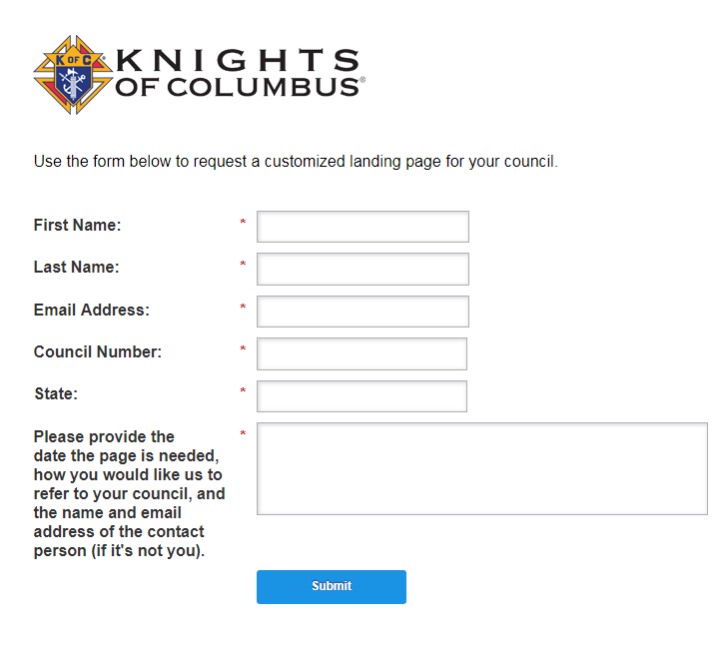
http://info.kofc.org/pagerequest.html

Slide 30
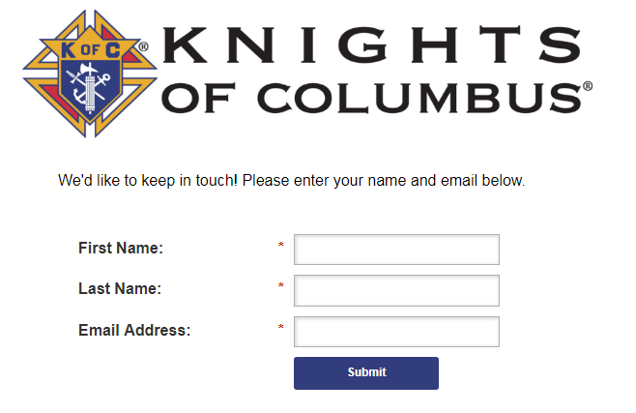
Creating Lead Generation Programs for Councils
The custom URL leads to a Marketo form simply asking for a prospect’s name and email address

Slide 31
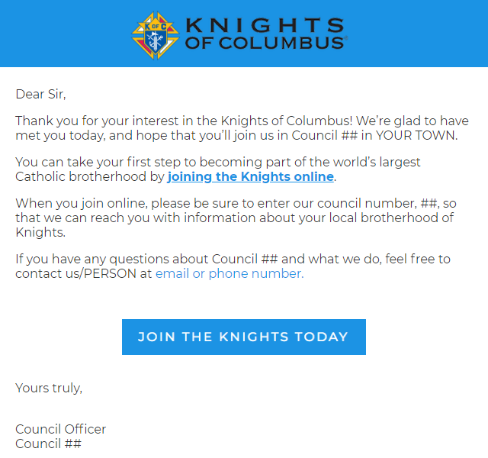
Once form is filled out, prospect immediately received a customized email from council with link to join the Knights of Columbus online:

Slide 32
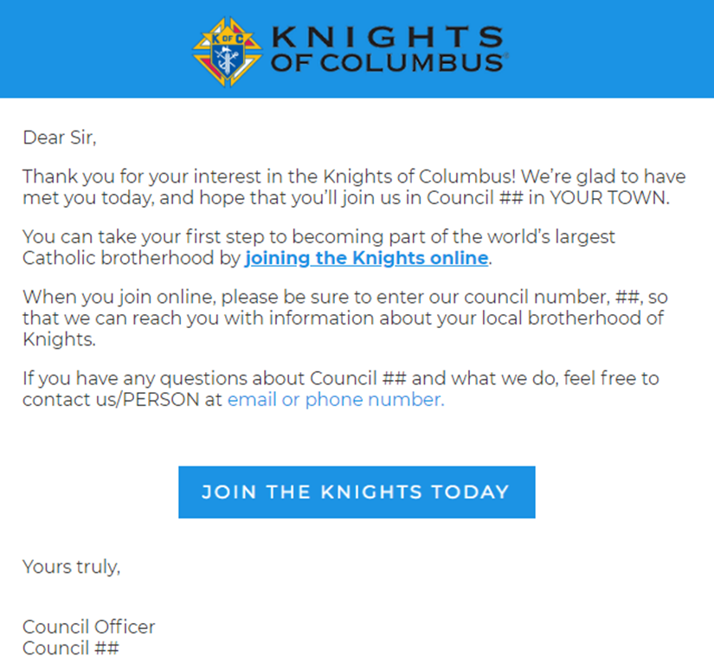
The prospect is also enrolled in a nurture drip-email campaign, which we are developing with Ketchum
Finally, the council receives a copy of all contacts enrolled via their custom Marketo form

Slide 33
Why is this Lead Generation Program a Win?
Ensures a consistent message to all prospective members
Allows local and State Councils can engage prospects personally, and automatically
Fosters goodwill-- it is an invitation, rather than a demand
Allows us to meet men where they are: on their devices, even in person

Slide 34
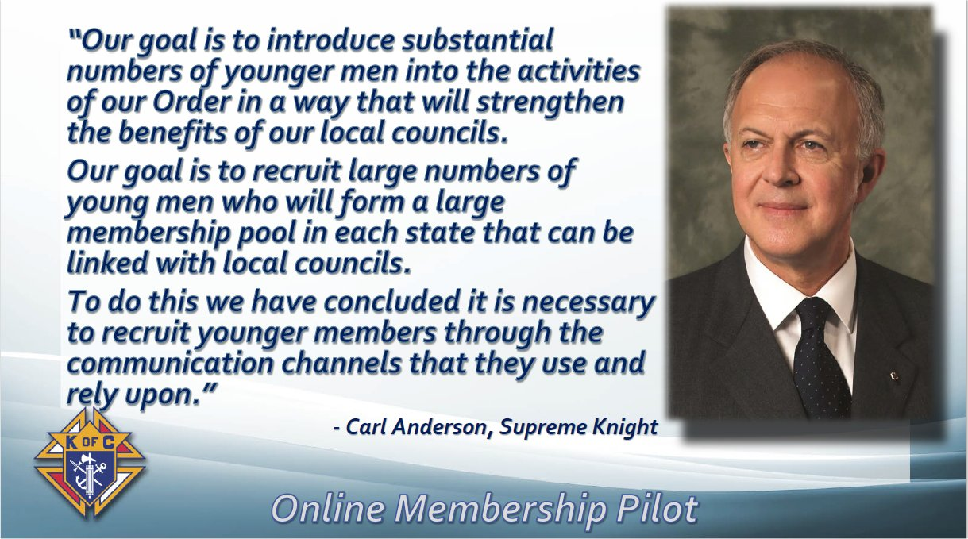

Slide 35
E-Membership What it does
Another tool to get new men into your council – First Step
Allows men to learn about the Knights where they are – online
Amplifies the Knights message

Slide 36
E-Membership What it not do
Does not change membership requirements
Does not eliminate degrees
Does not eliminate councils
Does not eliminate dues
Does not create a new member class

Slide 37
E-Membership What do they get
Welcome package
Access to Online Membership Portal
Communications
  Programs and events
Columbia Magazine
Access to Insurance and other benefits

Slide 38
E-Membership
http://kofc.org/un/joinus

Slide 39
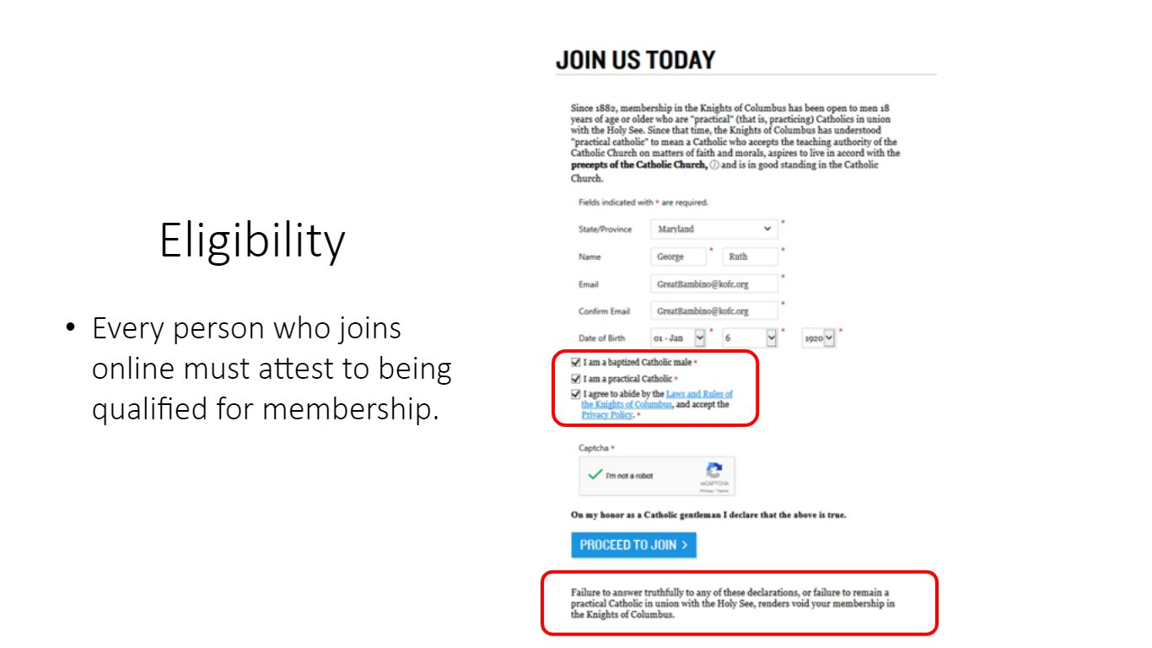

Slide 40
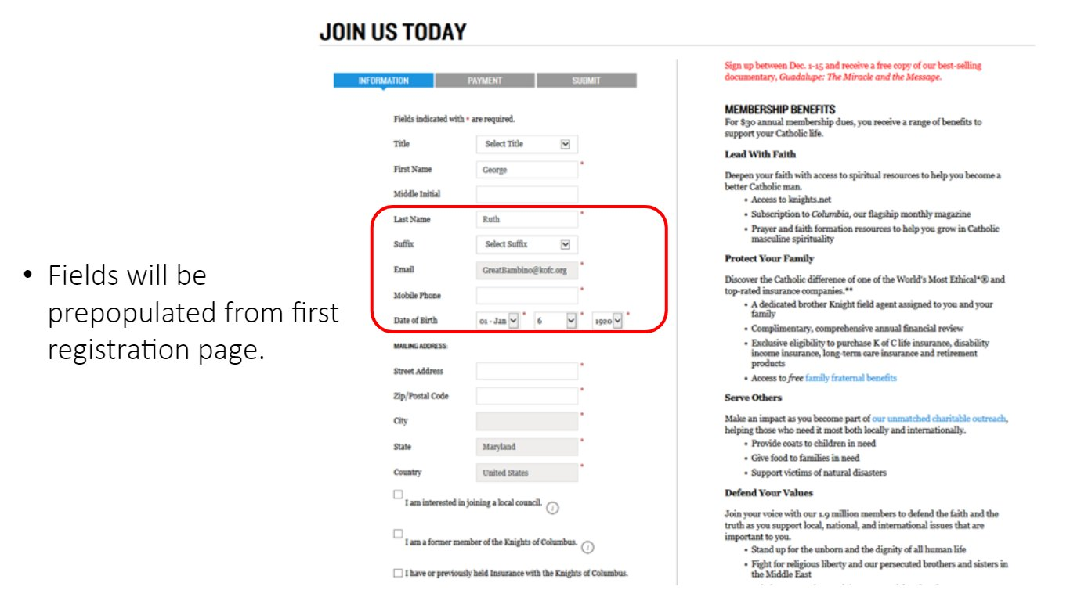

Slide 41
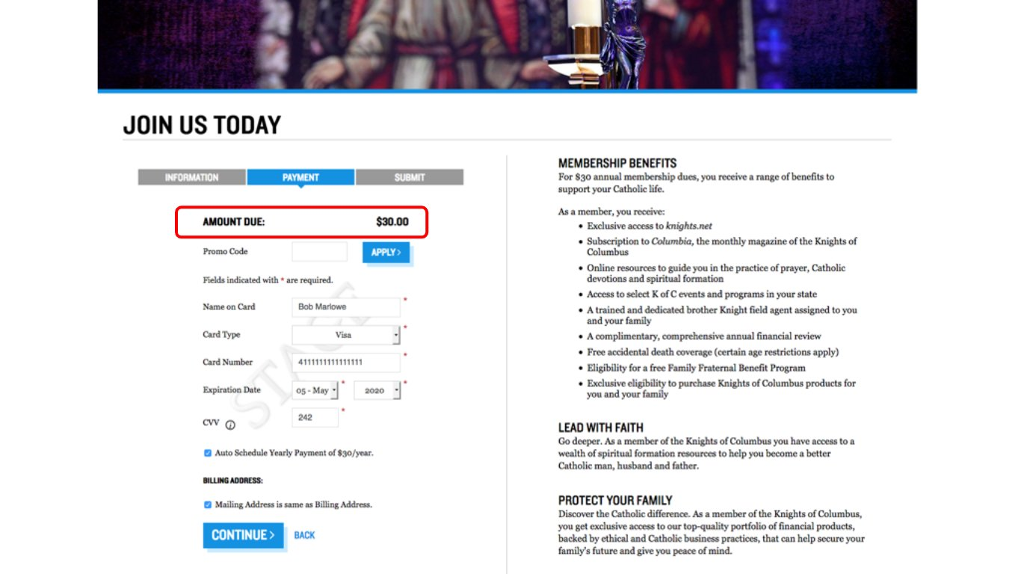

Slide 42
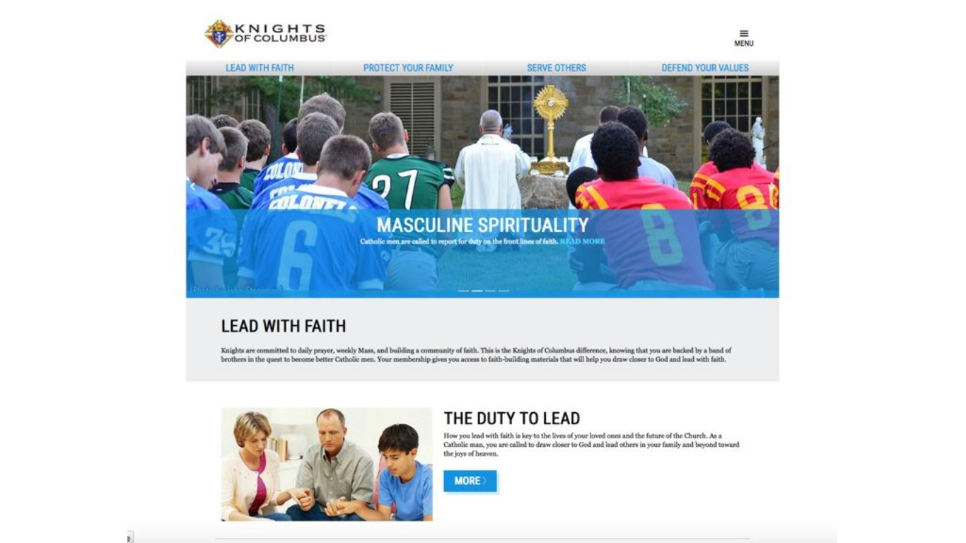
Notes:
This is one of the access points for on-line members to encourage them to get more involved. They will also be getting information on many of the programs offered by the Knights of Columbus, including faith formation and information about the founding principles of the order.

Slide 43
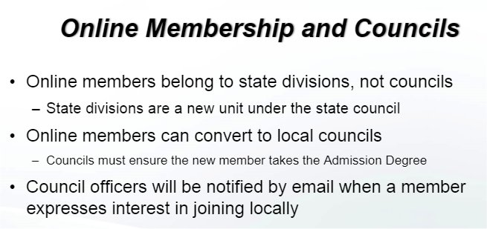
E-Membership

Slide 44
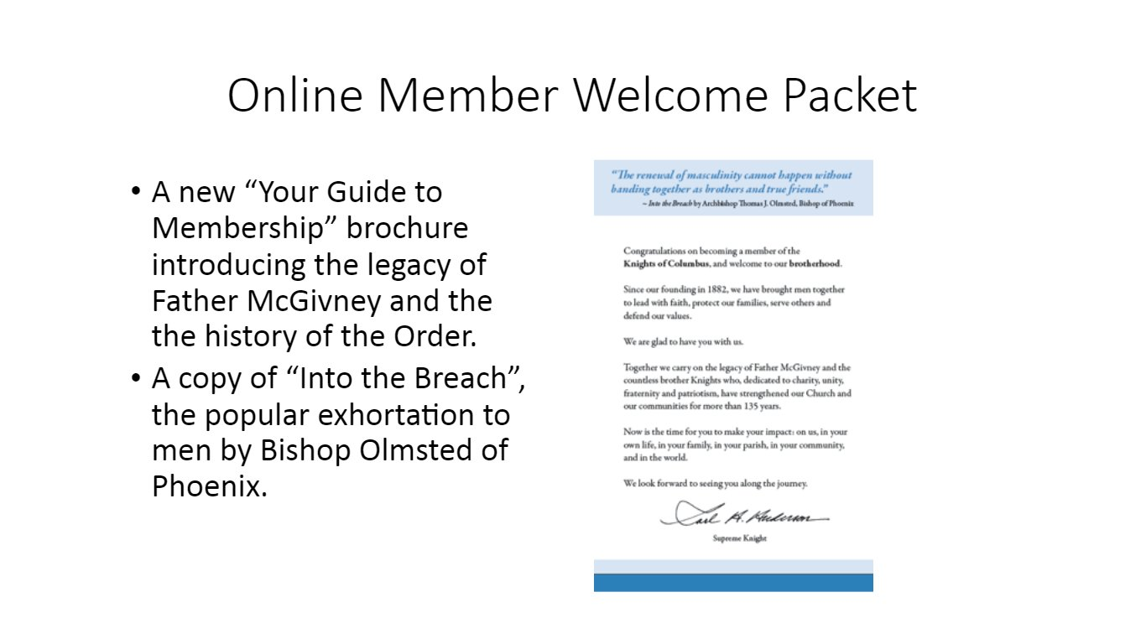
Notes:
This is one of the access points for on-line members to encourage them to get more involved. They will also be getting information on many of the programs offered by the Knights of Columbus, including faith formation and information about the founding principles of the order.

Slide 45
Retention – When does retention start?
  As soon as a member signs the form 100?
  After the first degree?
  When the member is a year behind in dues?

Slide 46
Retention – When does retention start?
  As soon as a member signs the form 100?
  After the first degree?
  When the member is a year behind in dues?
  Retention starts as soon as a member decides to join

Slide 47
Retention – What is role of the Retention Committee?
  Attempt to contact members before being suspended
  Contact members who are behind on their dues
  Contact to members to get them engaged in council activities
  The retention committee should maintain contact with members to make sure they are engaged in council activities

Slide 48
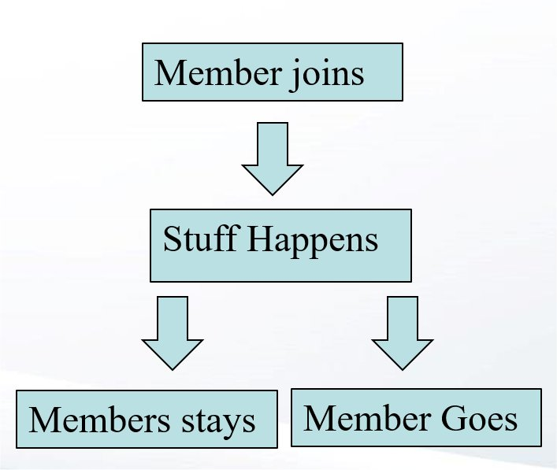
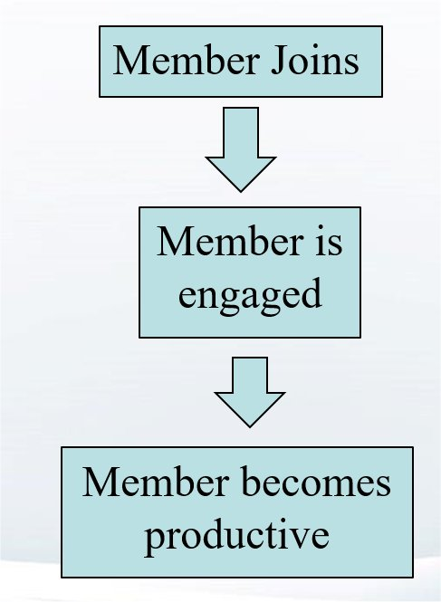
Retention – 2 paths

Slide 49
Retention – How do you engage members
  Assign a Mentor
    Someone with similar interests
    Someone they respect
    Someone skilled at reaching out to new members
  Mentor’s duties
    Shepard the new member into programs and activities
    Encourage advancement
    NOT force to attend meetings

Slide 50
Retention – How do you engage members
  Find out why they joined
  Find out about them, their family
  Pay attention to them
  Encourage them
  COMMUNICATE with them
  Recognize them

Slide 51
Retention – How do you engage members
  Keep a record of member involvement
    Note activities member enjoys
    Activities where member AND family are involved
  Ask members opinion and LISTEN
    After-Action function after activity
    New areas member wants to be involved.
  Make sure member a PERSON not a number

Slide 52
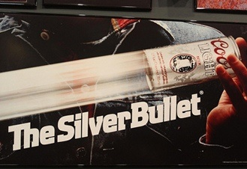
Retention
Retention begins before the Admissions Degree
You won’t find one of these
Every Council member should be considered a part of the Retention Team.

Slide 53
Resources - Training
kofc.org/TrainingMicrosite

Slide 54
Resources - Training

Slide 55
Resources - Webinars

Slide 56


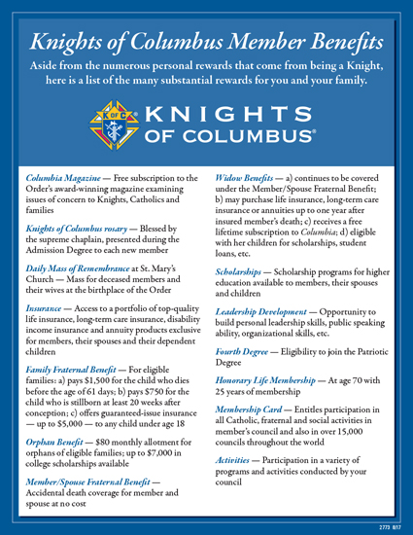
Council Membership Growth
Recruitment Plan - Materials
24 Hours can change your life(10099)
Why You Should Become a Knight
  (100100)
Prospect Cards
  (921A)
Member Benefit Flyers
  (2773)
Notes:
Church Kits is CRD-KIT-G and contains these and a suggested pulpit announcement (10067), 10 keys to Membership and Recruiting Success (10233), and Membership Recruitment and Retention Manual (10237) Prospect cards are in important because they allow you to get the recruits information. In a church drive or when talking to potential new members, the prospect card may be more important than the form 100.

Slide 57



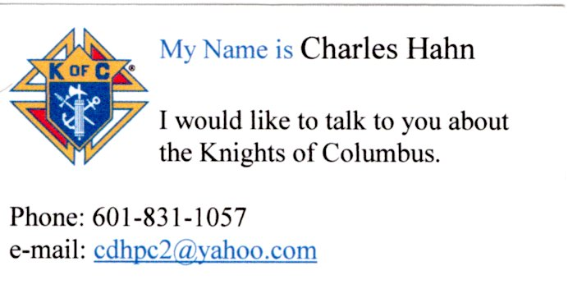
Council Membership Growth
Recruitment Plan - Materials
Suggested Remarks for Recruitment (10067E)
Why Join
  (10537)
Family Benefits Flyer
  (2761E)
Contact Card
Notes:
Other material which might be helpful. Contact card useful for handing to a man when you collect his info on a prospect card so he can remember you

Slide 58
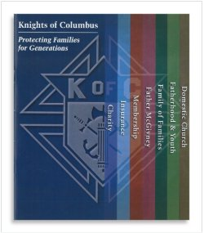
Council Membership Growth
Recruitment Plan - Materials
Protecting Families for Generations - 10395E
Notes:
Other material which might be helpful. Contact card useful for handing to a man when you collect his info on a prospect card so he can remember you

Slide 59
New Seminarian
E-Membership
New Seminarian Membership
  Free Membership
  Through E-Member program
  Enter Code “SEM18” in Promo Code box on Payments Page
Traditional Method
  Urge Councils to wave all fees
  Per Capita still paid (?)

Slide 60
Membership
Question?

Slide 61
Membership
Charles Hahn
418 Elmwood
Vicksburg, MS 39180
601-831-1057
membership@kofc-ms.org

