Slide 1
Membership
Charles Hahn
Membership Director

Slide 2
Star Councils 2018-19
4 Star Councils
1522 – Bay St. Louis
8038 – Pearl
9673 – Woolmarket
11995 – Pass Christian
2 Councils >75%
6 Council >50%
As of 6/28/2019
10 Councils Earned Father McGivney (Membership)
7854 - Clinton
8054 - McComb
8285 – Jackson, St. Therese
8760 – Holly Springs
9409 – West Biloxi
10901 – Oxford
11541 – Gulfport
14051 – Olive Branch
15121 – Poplarville
16433 - Waveland

Slide 3
Star Councils 2018-19
18 Councils Did not Recruit
1034 | 1605 | 2134 | 2945 | 5267
5556 |  | 7211 | 7915 | 9234
9958 | 10499 | 11904 | 11956 | 12166
12271 | 12331 | 13936 | 15155

Slide 4
Star Districts 2018-19
District 2 – 111%
Denny Fink
District 10 – 112%
Elvis Gates

Slide 5
State Membership Review
Goal – 360
Gain - 255

Slide 6
E-Membership
16 New E-Members in 2018-2019
9 of those still not transferred
13 total in assigned list – not transferred
Oldest 5/23/2018
Council | 5267 | 7854 | 7974 | 8285 | 9094 | 10443 | 11541 | 11934 | 15131
Number | 2 | 1 | 3 | 1 | 1 | 1 | 1 | 2 | 1

Slide 7
Membership E-membership
What do you not like
about e-membership?

Slide 8
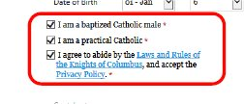
Membership E-membership
Vetting – Anybody can join

Slide 9
E-Membership How they joined
New Member Reg Source | Count | Percentage
Agent | 6 | 16.7%
Email | 3 | 8.3%
KofC Website | 1 | 2.8%
Member | 17 | 47.2%
Newspaper | 1 | 2.8%
Other | 7 | 19.4%
Social Networking | 1 | 2.8%
Total | 36 | 100.0%
Notes:
For Mississippi

Slide 10
E-Membership Why they joined
65% were recruited by a Knight
Many join because no one asked them
101 year old man in New England
Joined as e-member
Asked why –
No one asked for 70 years.

Slide 11
2019-2020 Membership Preview
Path to
Star Council
Star District
Circle of Honor

Slide 12
Incentives
Fast Start
Individual
Star Council Incentive

Slide 13
Incentives Fast Start
Drawing for $100 checks
July Only
20 new member threshold
1 new member – 1 entry
2 winners – Each $100 check
Council also wins $100 check
FS must send copies of Form 100 to membership@kokc-ms.org

Slide 14
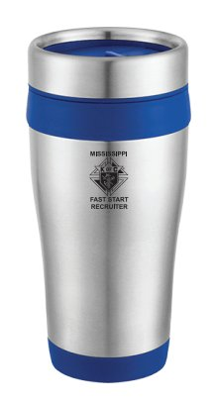
Incentives Individual
First 50 proposers
receive Mississippi
Fast Start Recruiter
Travel Mug
FS must send copies of Form 100 to membership@kokc-ms.org

Slide 15
Incentives Star Council
All councils meeting recruiting and insurance requirements by Jan 15, 2020
Receive ½ year credit in state per capita assessment
May also receive ½ year Supreme per capita credit

Slide 16
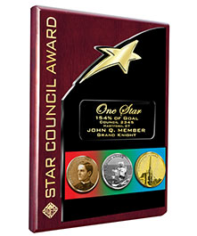
How do we get there?
Develop Recruiting Plan
Set Monthly Goals
Get Chaplain’s Assistance
Be Proactive
Use Programs for Recruiting
We are a Team
Use Available Resources
Get Outside Help if Necessary

Slide 17
Recruiting Opportunities
Parish Social – Cooking
Get non – members to help
Show council support for parish
Ministry Description
About the Knights of Columbus
Personal Story – Why I joined
Describe Programs
Young Adult Social
Get to know young adults in the parish
Interact with young adults

Slide 18
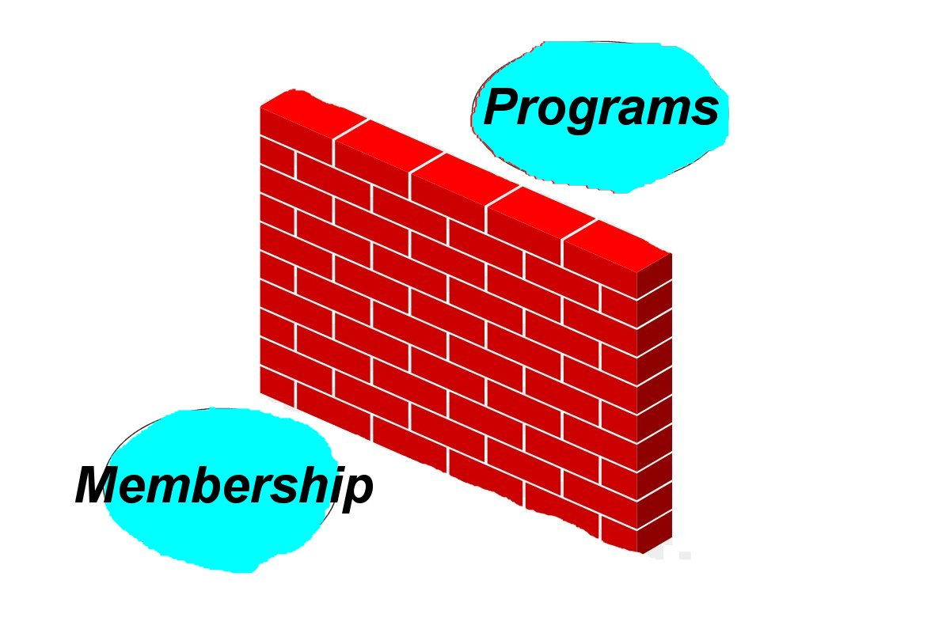
Recruiting Opportunities

Slide 19
Recruiting Opportunities
Recruiting
Programs

Slide 20
Recruiting Tools
Personal Relationships
Church Drives
KC Functions
Landing Page
E-membership

Slide 21
My Contact
Charles Hahn
418 Elmwood
Vicksburg, MS 39180
601-831-1057
membership@kofc-ms.org

