Slide 1

2025 School of Columbianism
Reports

Slide 2
Reports
Why Do Program Reports?
Let Supreme/State know what you are doing
Records for Program Awards
Tell others of Councils good works
Why Not Do Program Reports
Keep Council Programs Secret
Grand Knight is Lazy
“We don need no stinkin’ awards”

Slide 3
Reports
Supreme Reports/State Reports
Form 185 (Officers)/State Directory Update
Form 365 (Service Personnel)
Form 1295 (Semi Annual Audit)
Form 1728 (Fraternal Survey)
SP-7 (Columbian Award)/Program Reporting
Form 10784 (FIA)

Slide 4
Reports
Where to find them:
https://www.kofc.org/en/for-members/resources/council-forms.html

Slide 5
Reports
Form 185/Form 365
https://ms-kofc.com/HowtoEnterCouncilOfficers.pdf
Form 185 Due 6/30
Form 365 Due 6/30
If done before 6/30 can copy current years data and edit as necessary
(not state website)
Notes:
18 councils have not submitted Form 185 as of 7/25. 32 Councils have not submitted Form 365 as of 7/25.

Slide 6
Reports
Form 1295 – Semi Annual Audit
https://www.kofc.org/en/forms/council/audit1_1295_p.pdf
Due 8/15
https://www.kofc.org/en/forms/council/audit2_1295_p.pdf
Due 2/15
Filled out by Trustees ands GK with input from FS and Treasurer

Slide 7
Reports
Form 1728 – Fraternal Survey
Only FS or GK can submit
Report of Charitable Works of Your Council
Used to support non-profit status
Due 1/31

Slide 8
Reports
Form SP-7 – Columbian Award Application
4 Programs in each FIA area
Required for Star Council
Anyone can submit (?)
DUE 6/30
Notes:
32 Council did not submit SP-7 last year. 4 Denied

Slide 9
Reports
Form 10784 – Fraternal Programs Report
Customized for standard programs
Works for non-standard programs
Records man-hours and dollars
Anyone can submit
Grand Knights best friend

Slide 10
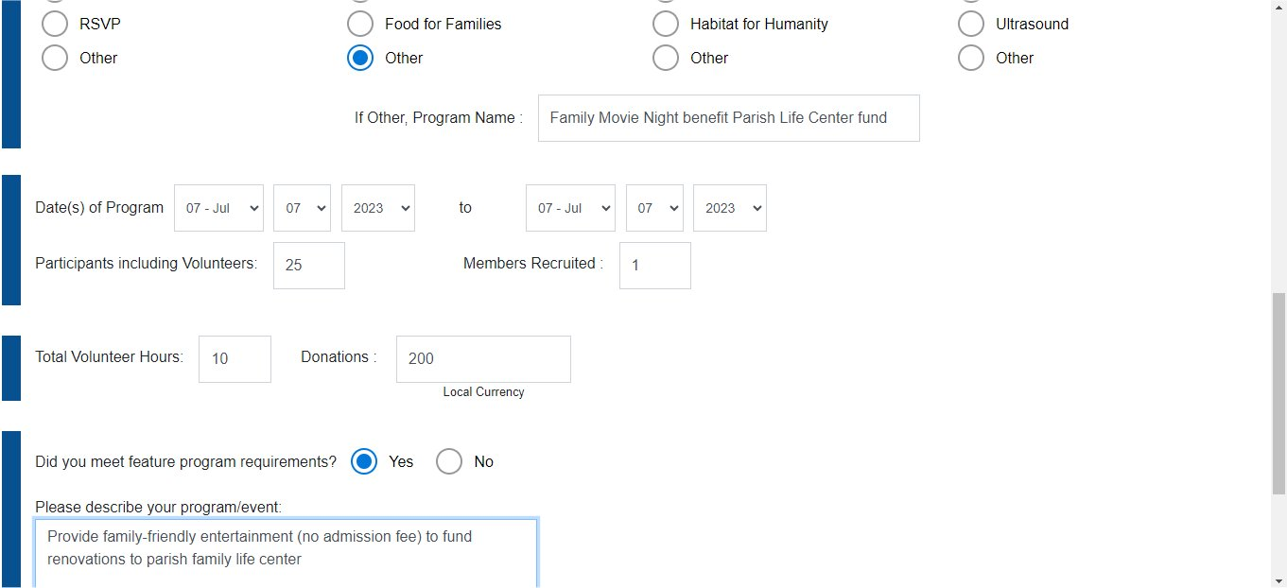
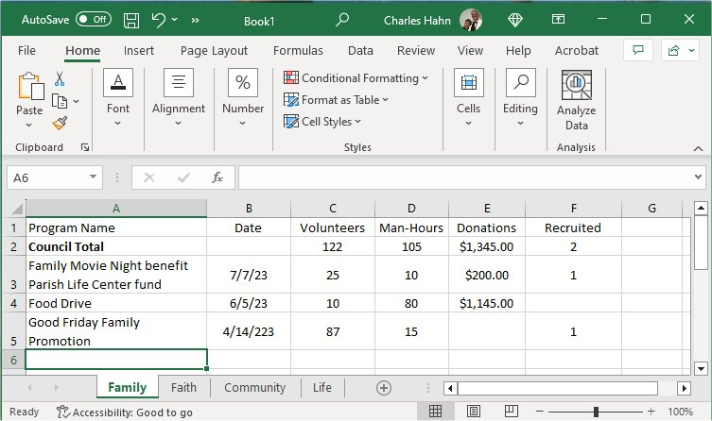
Reports – Form 10784
Transfer numbers from report to spreadsheet
Spreadsheet provides totals for 1728
Spreadsheet provides programs for SP-7

Slide 11
Other Reports
10057 – Food for Families
Refund Application
2863 – RSVP Refund Application
ASAP Grant Application
Provide council incentives to do specific programs

Slide 12
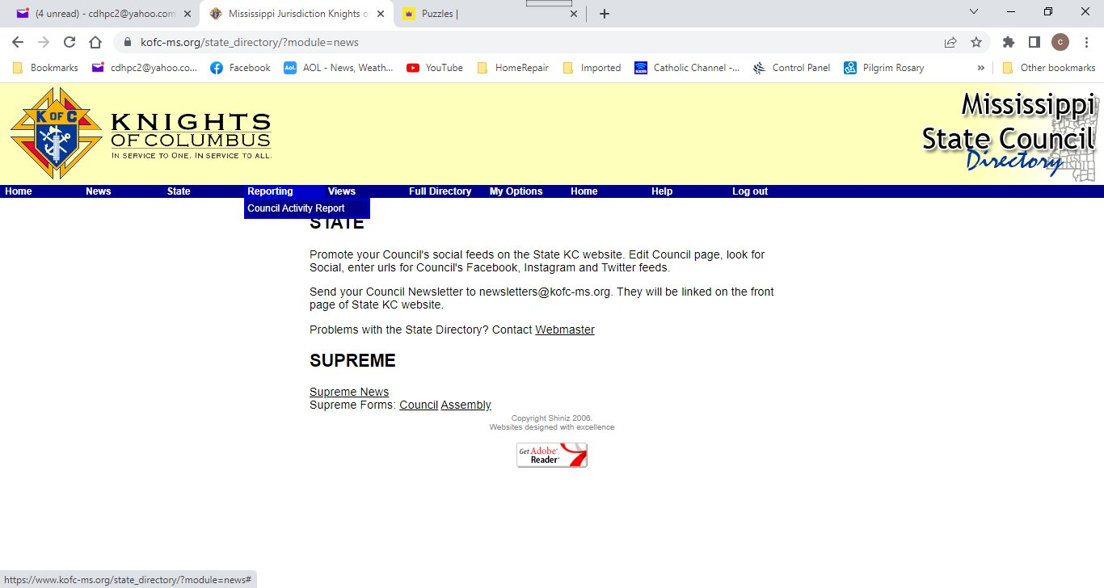
State Reports

Slide 13
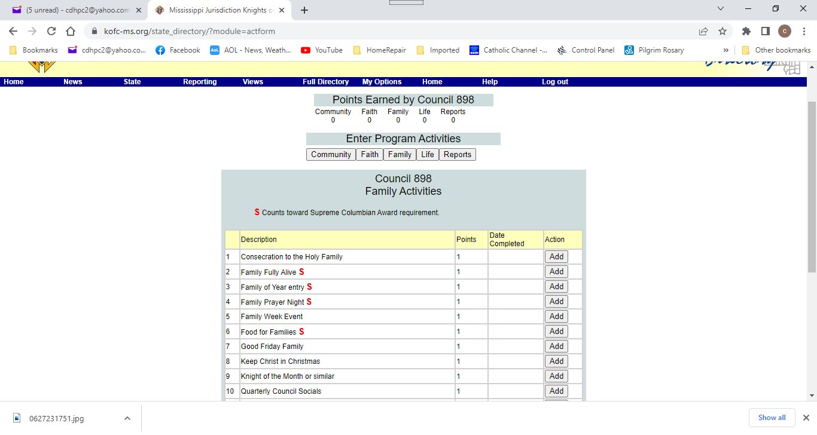
State Reports

Slide 14
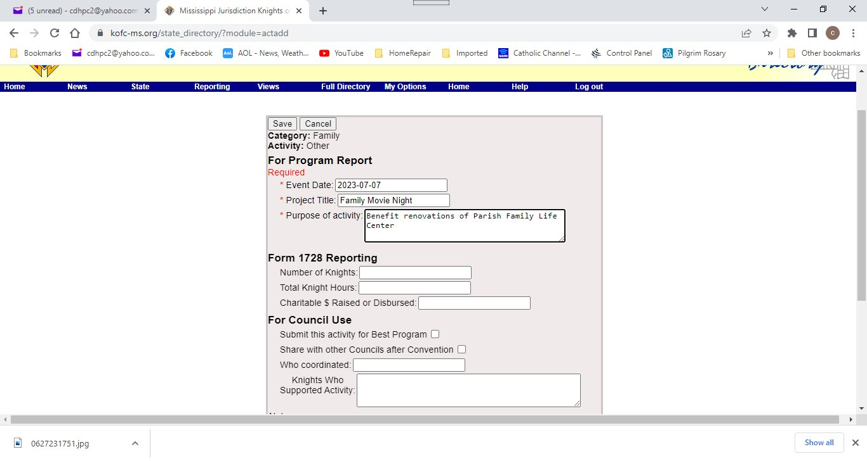
Reports – Form 10784

Slide 15
Reports
Send State Deputy’s Copy to:
Reports@kofc-ms.org
Not
stdeputy@kofc-ms.org
Or
State deputy’s personal email

Slide 16
Program Awards
State Awards
Honor Council – 5 programs in each area
Superior Council – 8 programs in each area
Council of Excellence – 6 Programs and Membership
Distinguished Council – 6 Programs and Membership and FBEs
Stellar Council – 8 Programs, Membership and FBE
Found on state directory at https://kofc-ms.org

Slide 17
Program Awards
Other State Awards (due March 15)
Best Council – Why your council is the best in the state
Family of the Year – Must be submitted TO STATE as Family of the Month
Knight of the Year
Best Program (one submission in each area – Faith, Life, Community, and Family)
Best Vocations Program
→ Forms at https://kofc-ms.org/whats_new/award_forms.htm
→ E-mail submissions to stprograms@kofc-ms.org

Slide 18
Supreme Awards
Columbian Award
  4 programs in each FIA area
  Due 6/30 – Hard deadline
Father McGivney Award
  Achieve Membership goal
Founder’s Award
  Insurance Promotion
  Promote at least 2 FBE’s with total 10/14 eligible men in attendance
Star Council*
  Earn Columbian Award
  Earn Fr. McGivney Award
  Earn Founder’s Award

Slide 19
Supreme Awards
Other Requirements
Be Safe Environment Compliant
Submit Service Personnel – Form 365 (Due 6/30)
Submit Officers Chosen – Form 185 (Due 6/30)
Submit Annual Survey of Fraternal Activity – Form 1728 (Due 1/31)

Slide 20
Reports
Questions

